Slide 1
Viettel TV Description
(Viettel Telecom)

Slide 2
Revision History
Version | Date | Description | Author
1.0 | 2016.11.17 | initiation | HoangCH
2.0 | 2017.04.16 | New version for Viettel TV 2.0.0 | HoangCH

Slide 3
Contents
UI Structure
Usage Scenario
Menu & function description
Key policy
How to change languages

Slide 4
UI Structure
1st depth
2rd depth
3th depth
4th depth
Menu
VOD Category List
VOD Details
VOD Video Playback
Spotlight Contents (Recommended Contents)
Channel List
Channel Video Playback
VOD & Channel Slideshows ( Hot & new contents)
VOD Details
VOD Video Playback

Slide 5
Usage Scenario – Browser, Login and Play
Browsing VOD or TV Channel
View selected VOD or TV Channel
Press Enter Key to Play
Request Login
Play the content when login successfully

Slide 6
Usage Scenario – Purchasing
The Application doesn’t support purchasing at the moment. User have to purchase package service and contents via Smart Phone application of Viettel TV
Some contents cannot be play on Smart TV Application, at that case the application will show a message inform the user. User needs to buy STB Device to watch these contetns

Slide 7

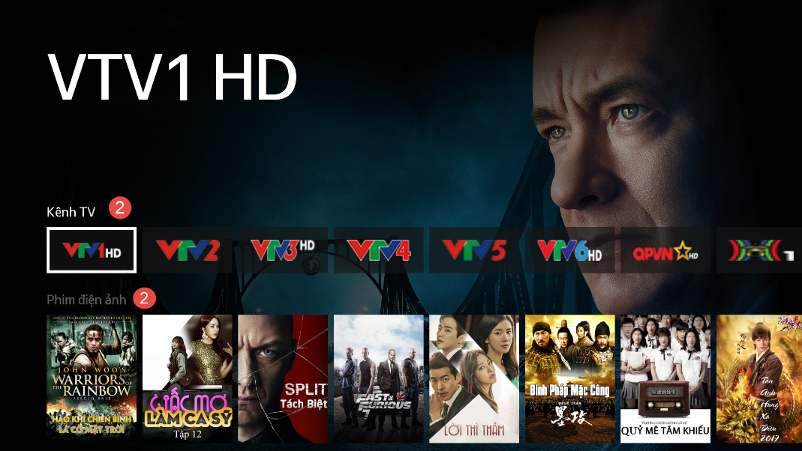
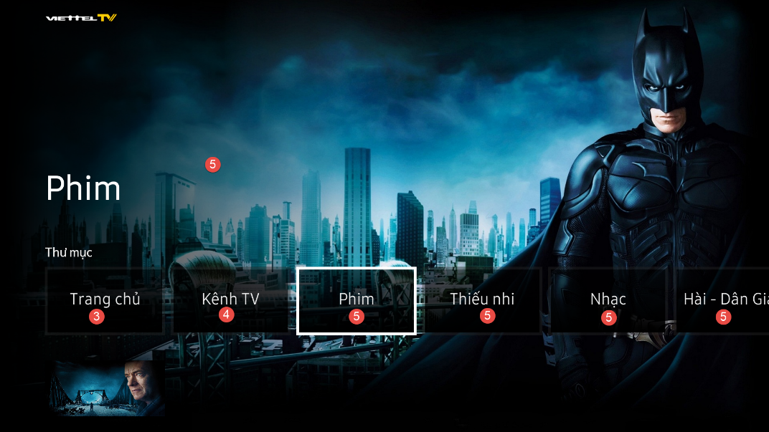
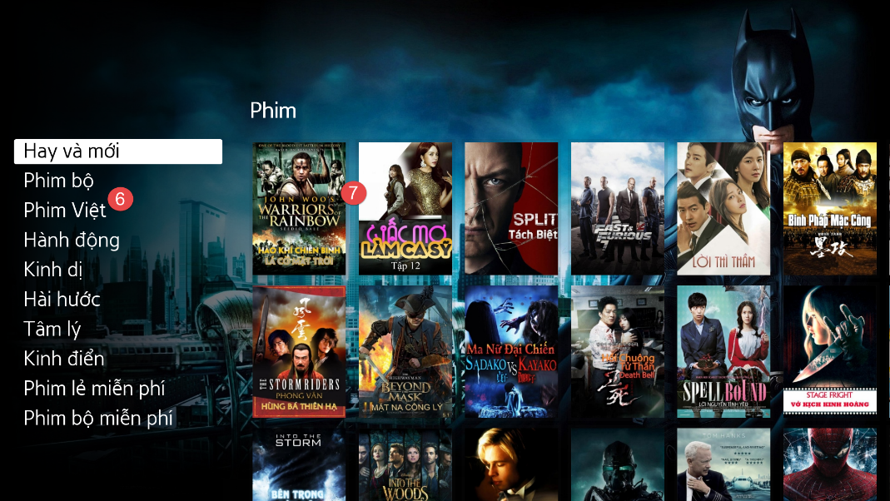
Menu & function description

Slide 8
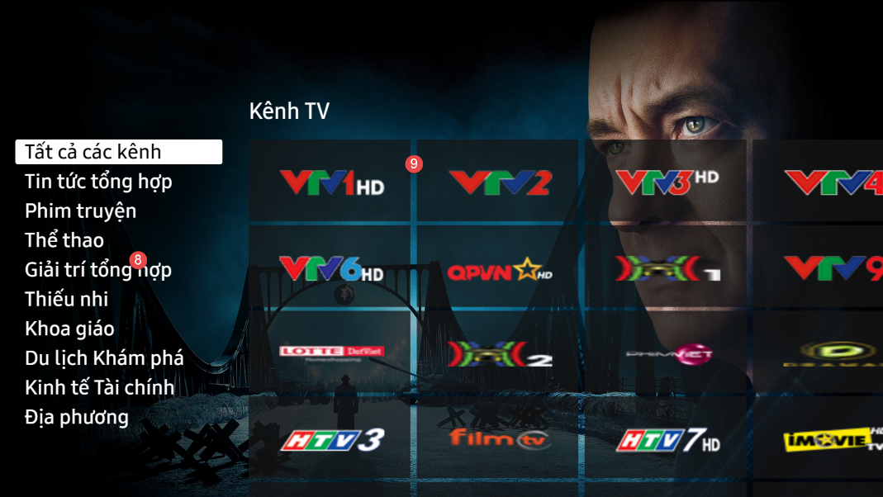

Menu & function description

Slide 9
Menu & function description
No | Element | Attribute
1 | Spotlight Contents | Show recommendation contents
2 | Chanel slideshow & Hot & new VOD slideshow | Show list of channels and hot & new vod contents
3 | Homepage Menu Item | Go to Homepage ( spotlight )
4 | Channel Menu Item | Go to channel categories
5 | Vod Category Menu Item | Go go VOD category page
6 | Sub VOD Category | Show sub VOD Categories
7 | VOD List | Show VOD list of Sub categories of categories selected
8 | Channel Category | Show list of channel category
9 | Channel Item list | Show list of channel service item of selected channel category
10 | VOD Details | Show VOD details of a selected VOD
11 | Related Contents | Show related VODs of selected VOD

Slide 10
Key Policy
Button | Action | Remarks
ENTER | Play Content when selected.
UP/DOWN | Move highlight to up or down
LEFT/RIGHT | Move highlight to left or right
RETURN | Move to previous page
EXIT | Close the app and show broadcasting channel

Slide 11
How to change languages
Items | Contents
How to change languages | multi languages are not supported

